Slide 1

Inventory & Supply Chain Tracker With Record Alerts
Data-Driven Solutions for Replenishment and Cost Management
By Prasam, Indraditya & Abhirup

Slide 2
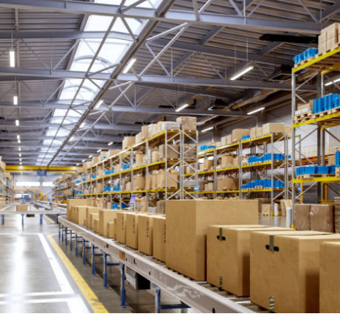
Problem Statement
01
Are we running out of stock?
Balancing product availability against warehouse storage costs.
02
Which products sell the most?
Identifying demand shifts to allocate stock accurately across regions.
03
Which suppliers are causing delays?
Understanding lead times to avoid supply chain bottlenecks.
04
Are we ordering the right quantities?
Pinpointing exact reorder points to maintain operational flow without bloat.

Slide 3
The Challenge
01
Inventory Management
Maintaining a delicate balance between having enough stock to meet demand and minimizing excess storage costs.
02
Demand Tracking
Identifying which products are selling the most and shifting inventory allocation based on regional performance.
03
Supplier Reliability
Tracking supplier lead times to identify which suppliers are causing delays and disrupting the supply chain.
04
Order Optimization
Determining the right quantities to order and the exact moment to reorder (Reorder Point) to prevent stockouts.

Slide 4
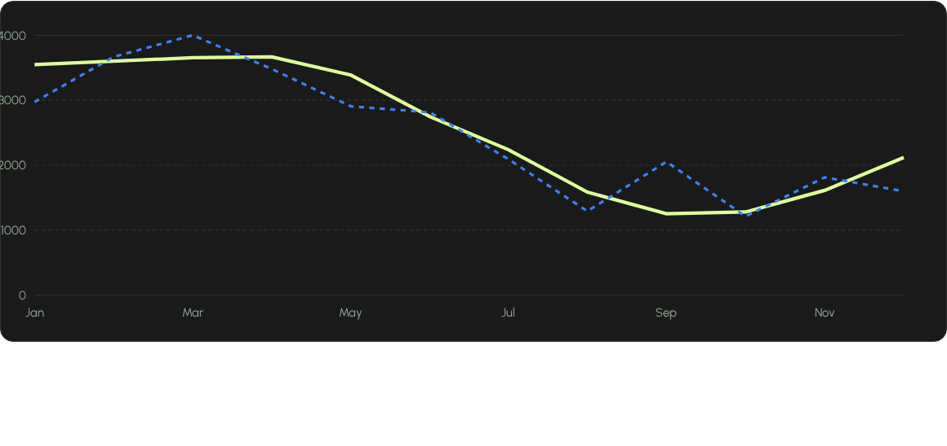
Replenishment vs. Demand Gap
While sales plummet drastically in September (1,260 units), the company ordered higher volumes (2,049 units), causing inventory levels to swell to over 68,000 units by October.

Slide 5
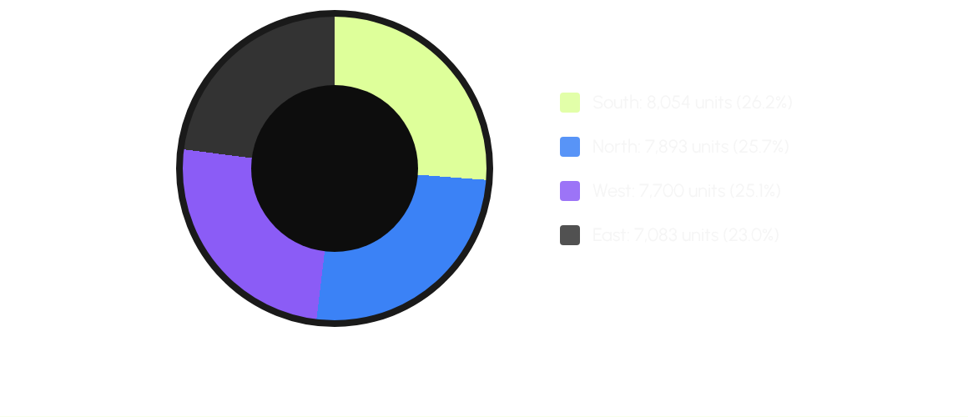
Regional Dominance
The South and North regions are the highest-performing sectors, representing over 50% of total sales (30,730 total units). Inventory allocation must be prioritized here.

Slide 6
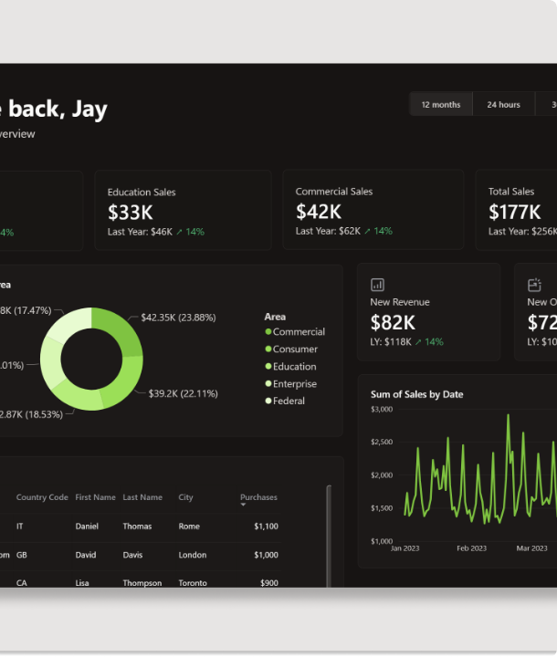
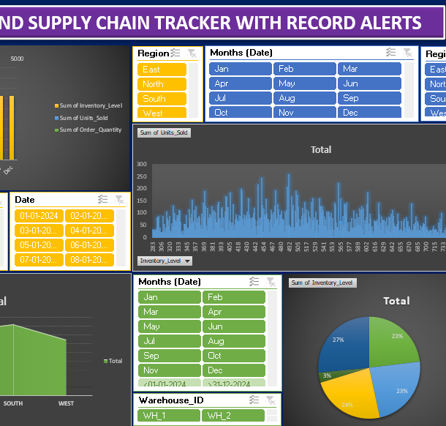
The Outcome
An interactive, automated Excel-based supply chain dashboard.
•
Live KPIs: Tracks Total Units Sold (30,730) and Total Inventory (764,143).
•
Dynamic Slicers: Filter 6 interactive charts by SKU, Warehouse, Supplier, and Region.
•
End-User Accessibility: Includes an "Instructions" sheet for non-technical stakeholders to easily navigate the tool.

Slide 7
Business Benefits
Cost Reduction By adjusting reorder points dynamically and aligning order quantities with the Q3/Q4 sales drop-off, the business eliminates end-of-year inventory bloat.
Optimized Replenishment Dynamic reorder points (averaging 338 units) act as a necessary buffer to prevent stockouts during supplier lead times (averaging 9 days, up to 14 days).
Strategic Planning Shift excess warehouse inventory from the East region to the South and North regions where demand is highest, maximizing sales potential.

Slide 8
Questions?
Thank you for your time.

Slide 9


Image Sources
https://media.istockphoto.com/id/2173612915/photo/modern-distribution-center-with-smart-automation.jpg?s=612x612&w=0&k=20&c=i3XBdA6JvNFoaOoX9PGUJxdKyOt6b4wqnfIOwa7_AF0=
Source: www.istockphoto.com
https://i.redd.it/some-dark-theme-dashboards-i-made-v0-ooylkecwqk4d1.png?width=5124&format=png&auto=webp&s=d4ab685774c55bb3e6acd16280ddb2e048ebf26c
Source: www.reddit.com

